Slide 1


Slide 2

The Problem
FINDING
RELEVANT
INFORMATION

Slide 3
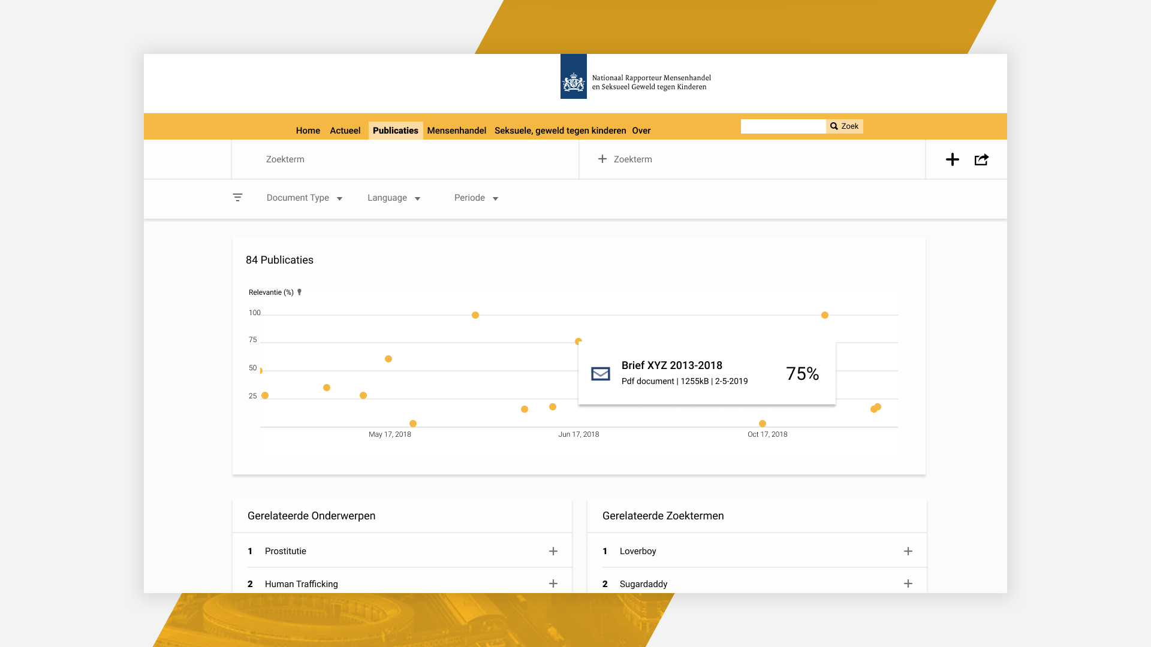

Slide 4
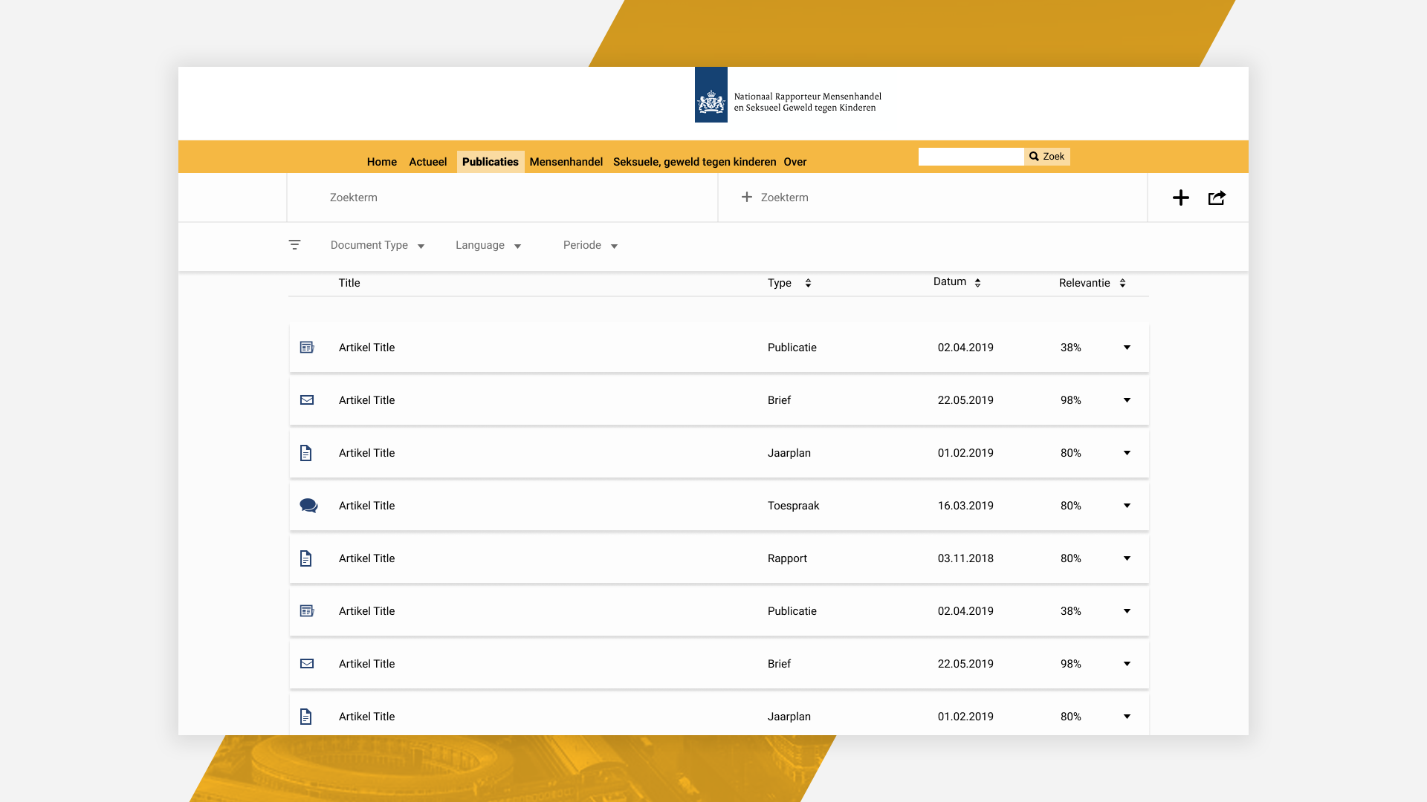

Slide 5
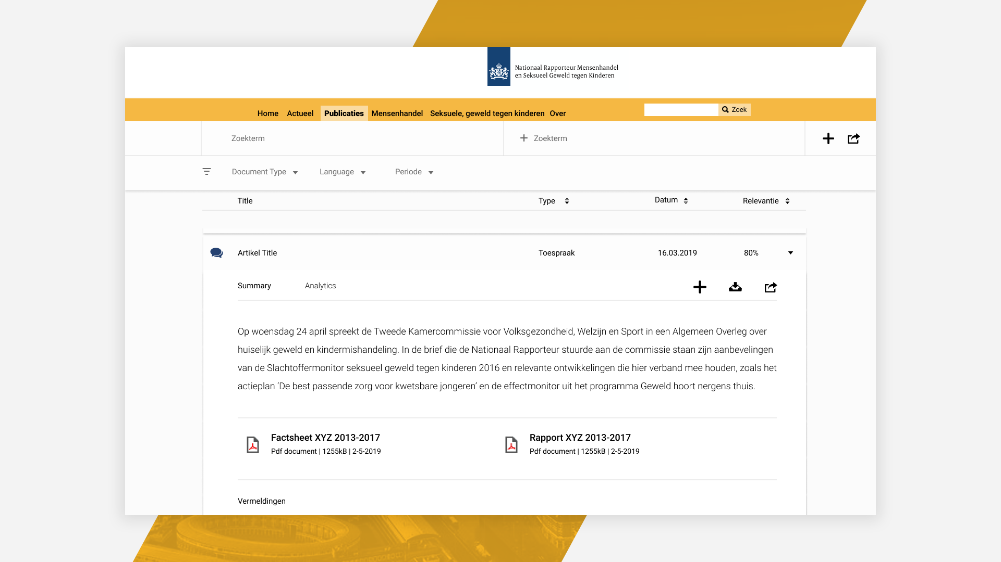

Slide 6
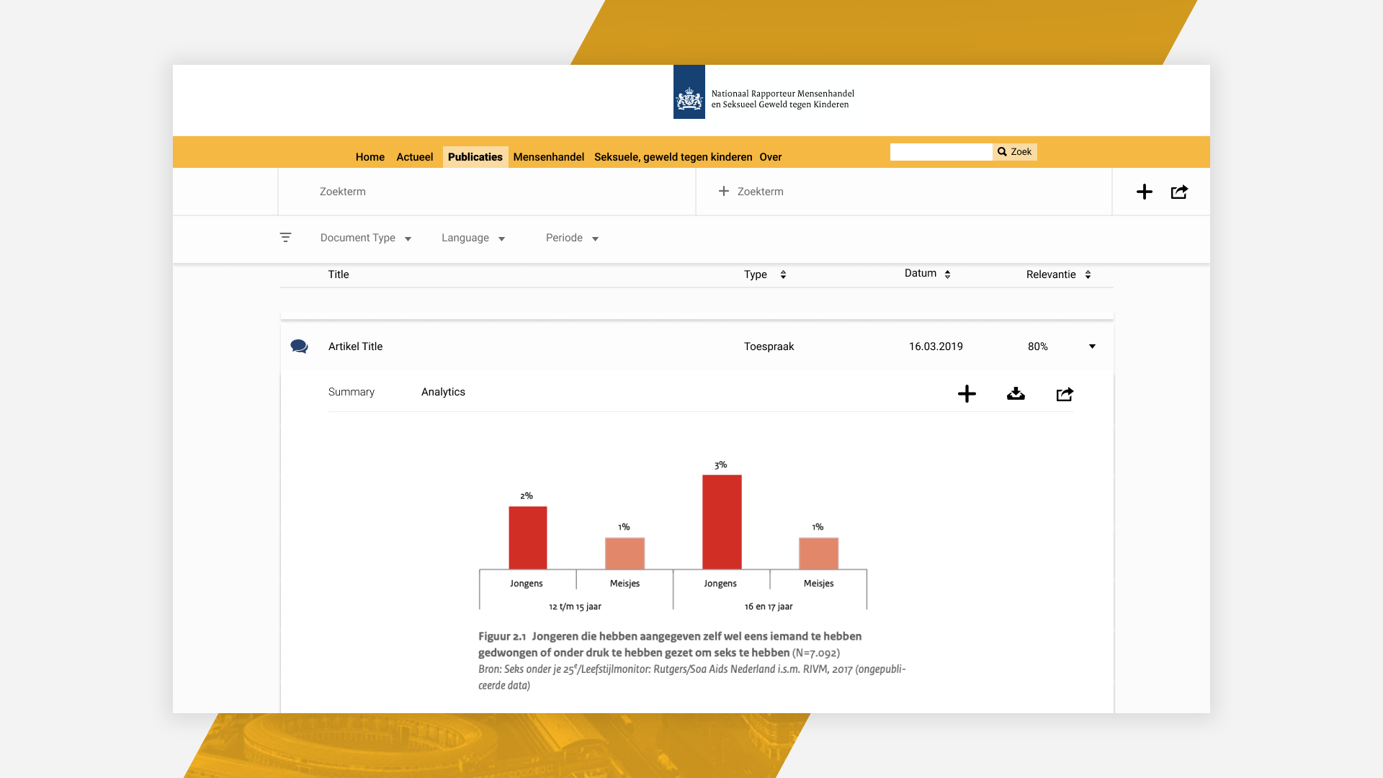

Slide 7
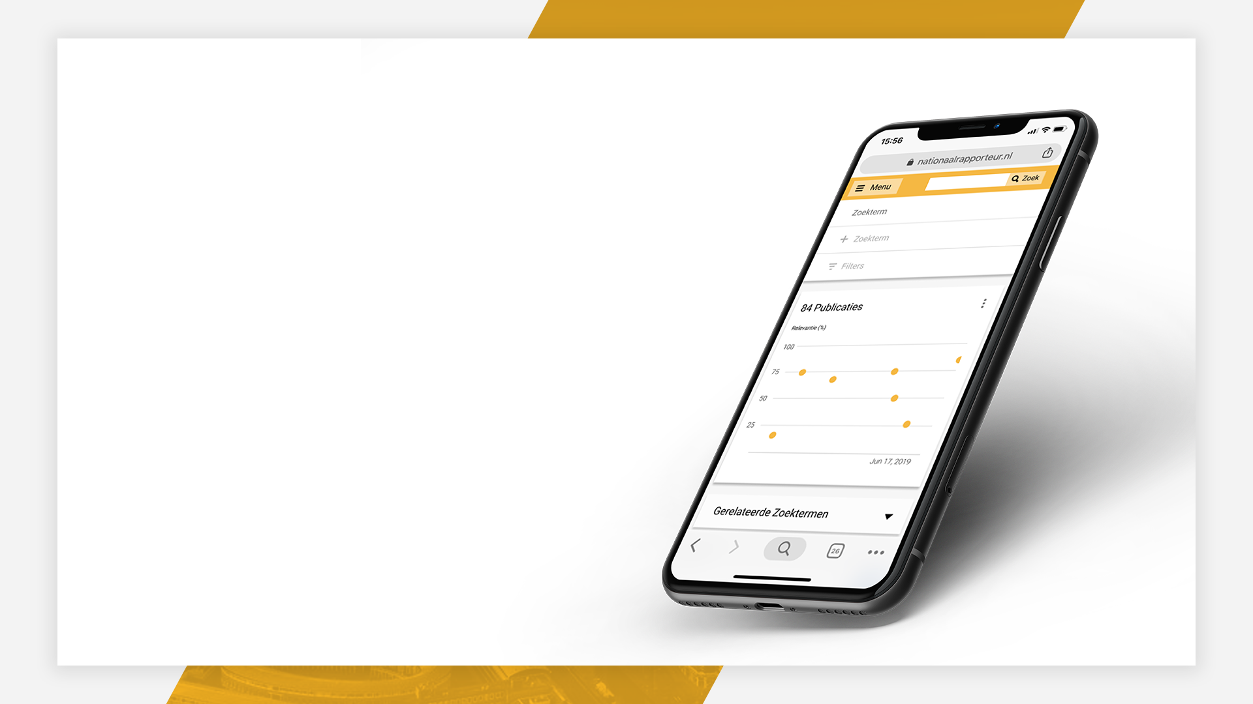
MOBILE
READY

Slide 8
READY TO
IMPLEMENT

